Slide 1
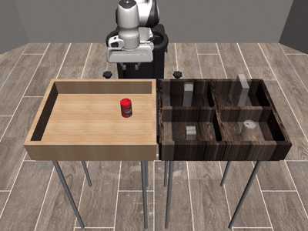
Hybrid Robot Trajectory Generation: Learned demonstration priors meet model-based diffusion
Zihao Sun and Charles Beck

Slide 2

Why combine priors and Model-Based Diffusion?
Pan et al.’s MBD data integration is a hard switch between model and demonstration data trust. What if you blend them continuously and does the cost still get to add anything?
Our project deals with a Franka Panda robot arm with 7 DoF on several complex manipulation tasks. This provides high dimensional controls on tasks with sometimes sparse reward functions.
BC alone | MBD alone | Our hybrid
smooth but drifts | cost-only, can't find basin | structured and cost-aware
Can: 6.7 % (4 / 60) | Can: 0.0 % (0 / 60) | Can: 86.7 % (Phase F best)

Slide 3
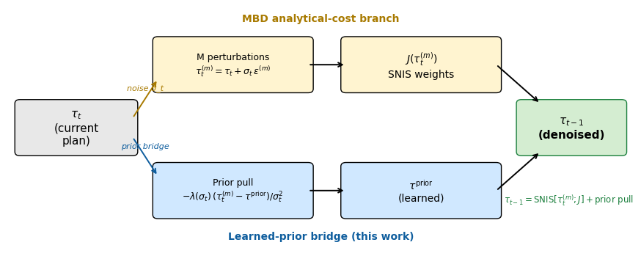
Composite Score: Blend the learned and analytical gradients
p^{data}: learned from demos
  BC / flow / retrieval / DP.
p^{model}: hand-designed cost J(τ)
  goal-distance, contact, grip.
λ(σ_{t}): noise-schedule-dependent
weight that blends them
  λ=0 recovers pure prior denoising
  λ→∞ recovers MBD
The yellow branch is the analytical-cost path; the blue branch is the learned-prior bridge. Both flow into the same τ_{t−1} update step on the right.

Slide 4
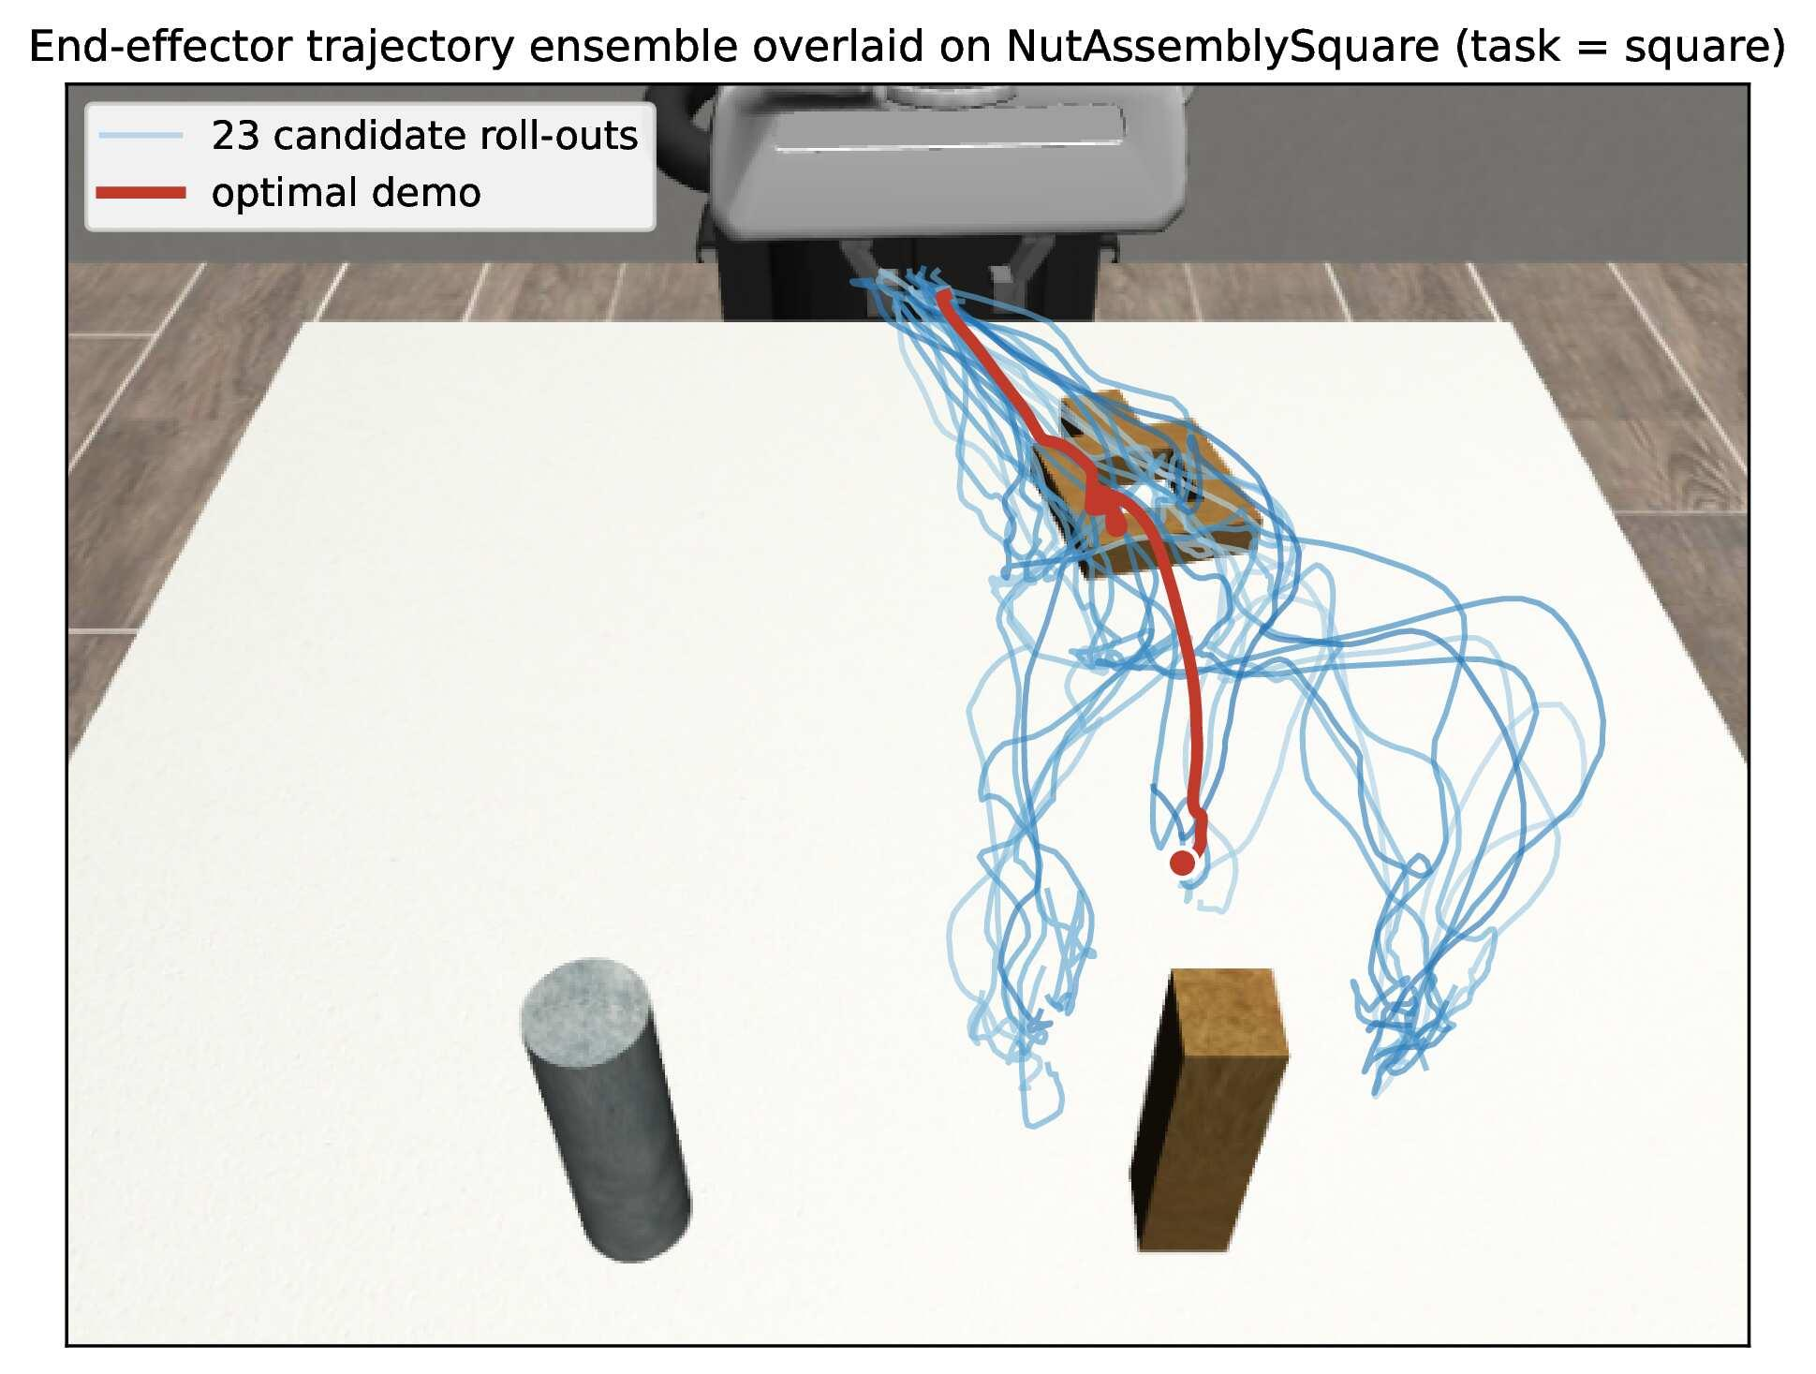
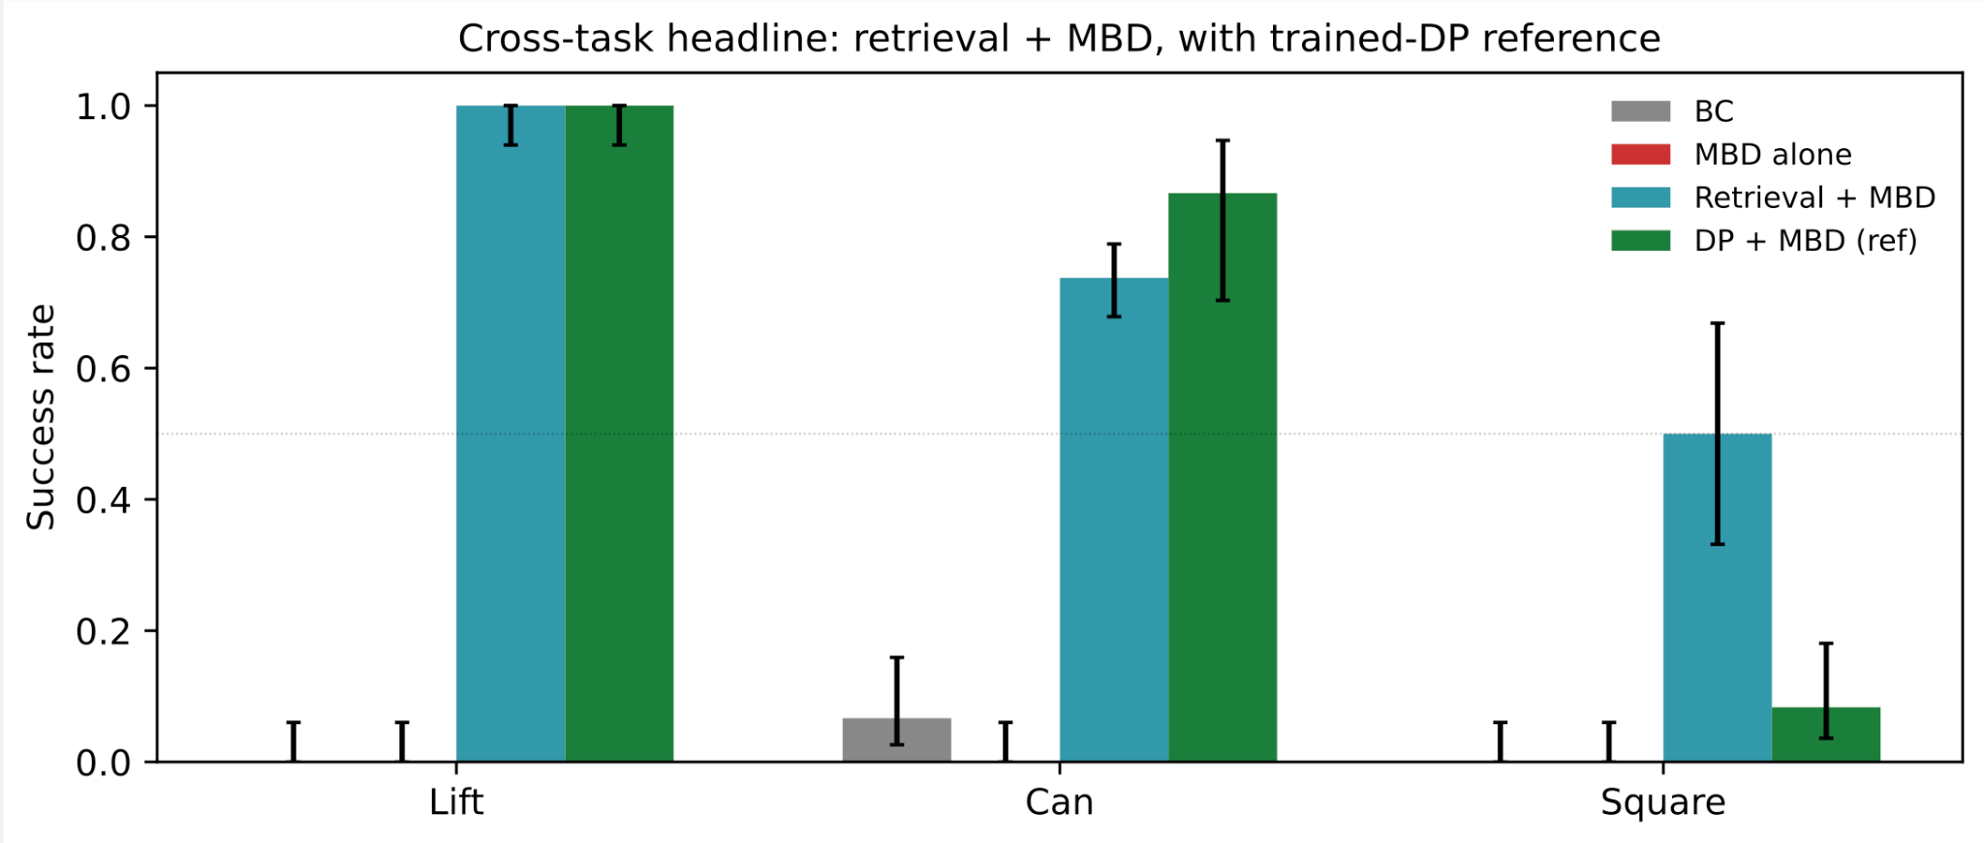
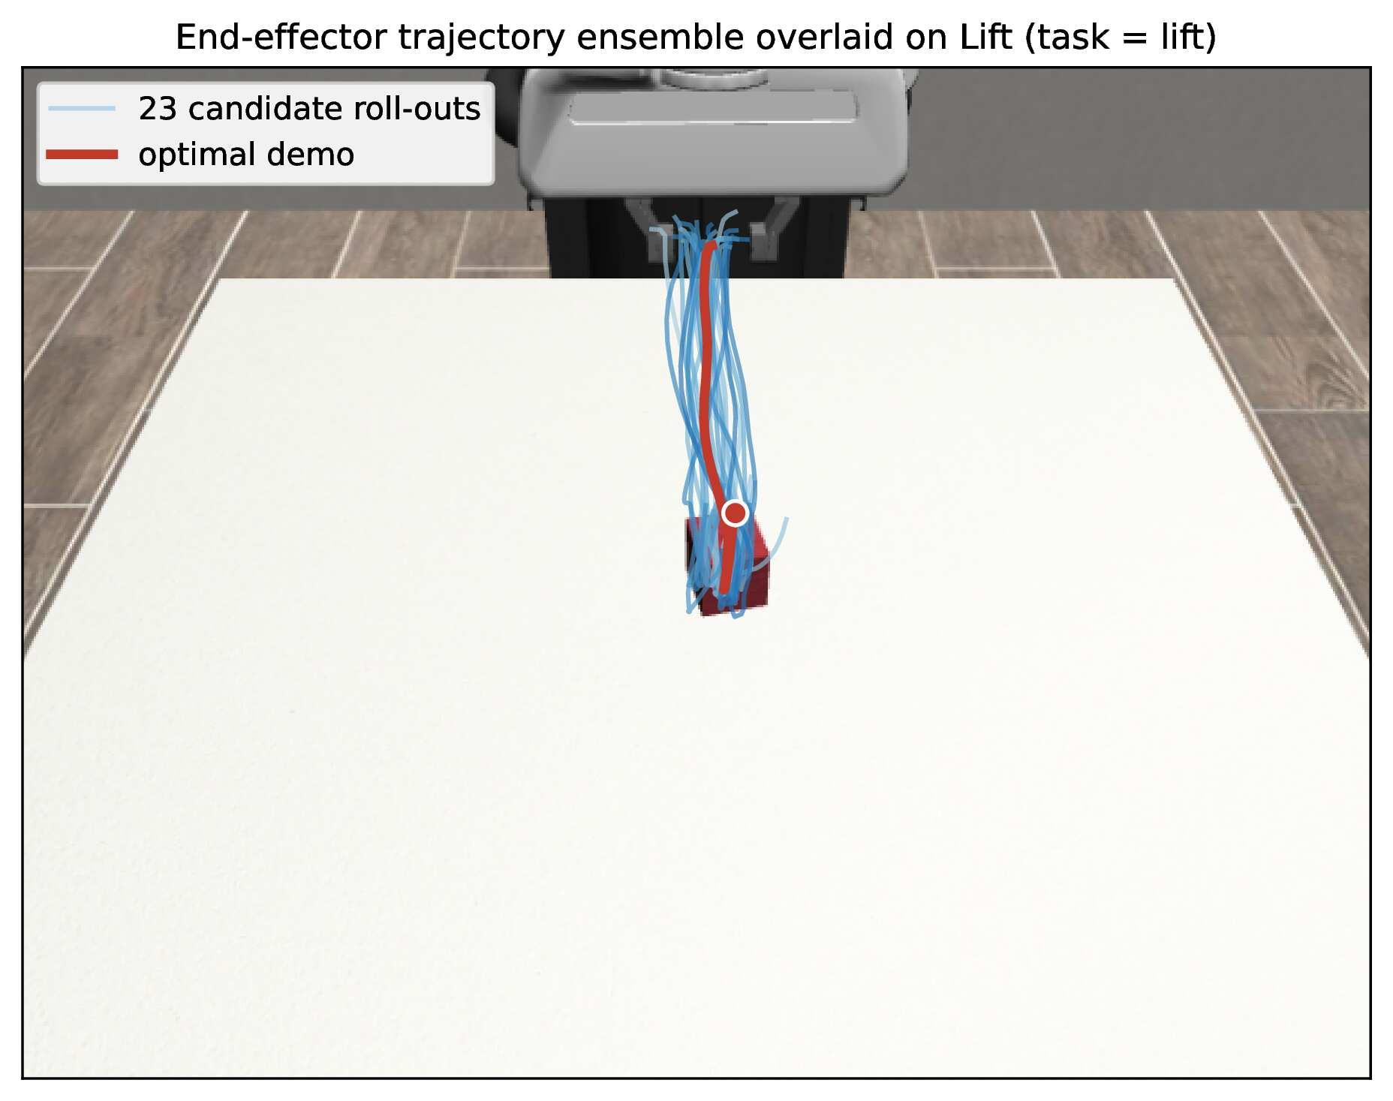
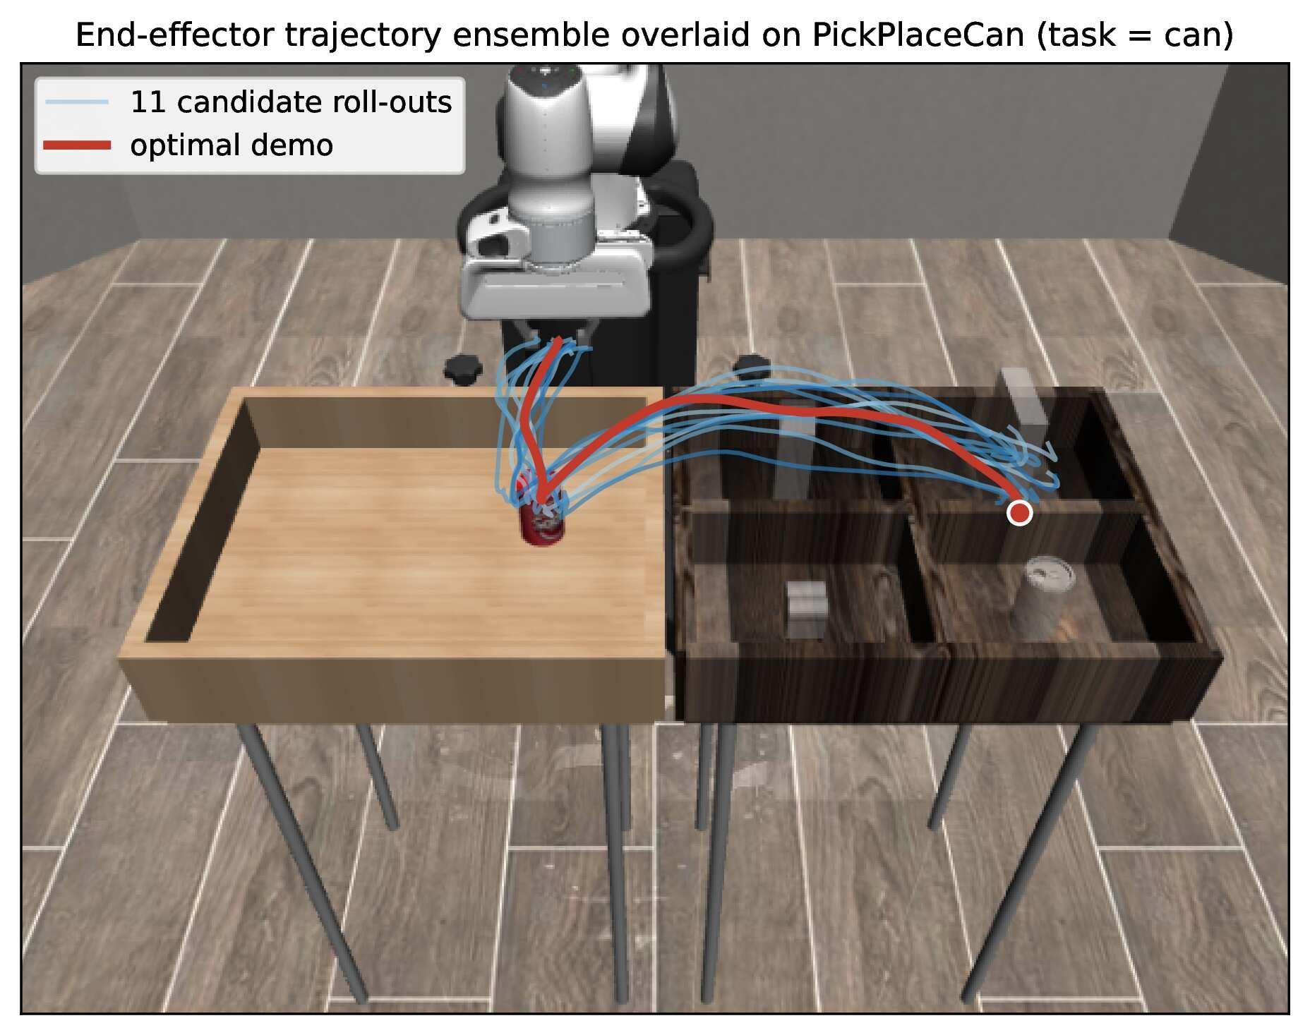
Cross-Task Results
Square is harder because the sparse success signal only appears after precise alignment and contact, so small errors are not corrected until very late.

Slide 5
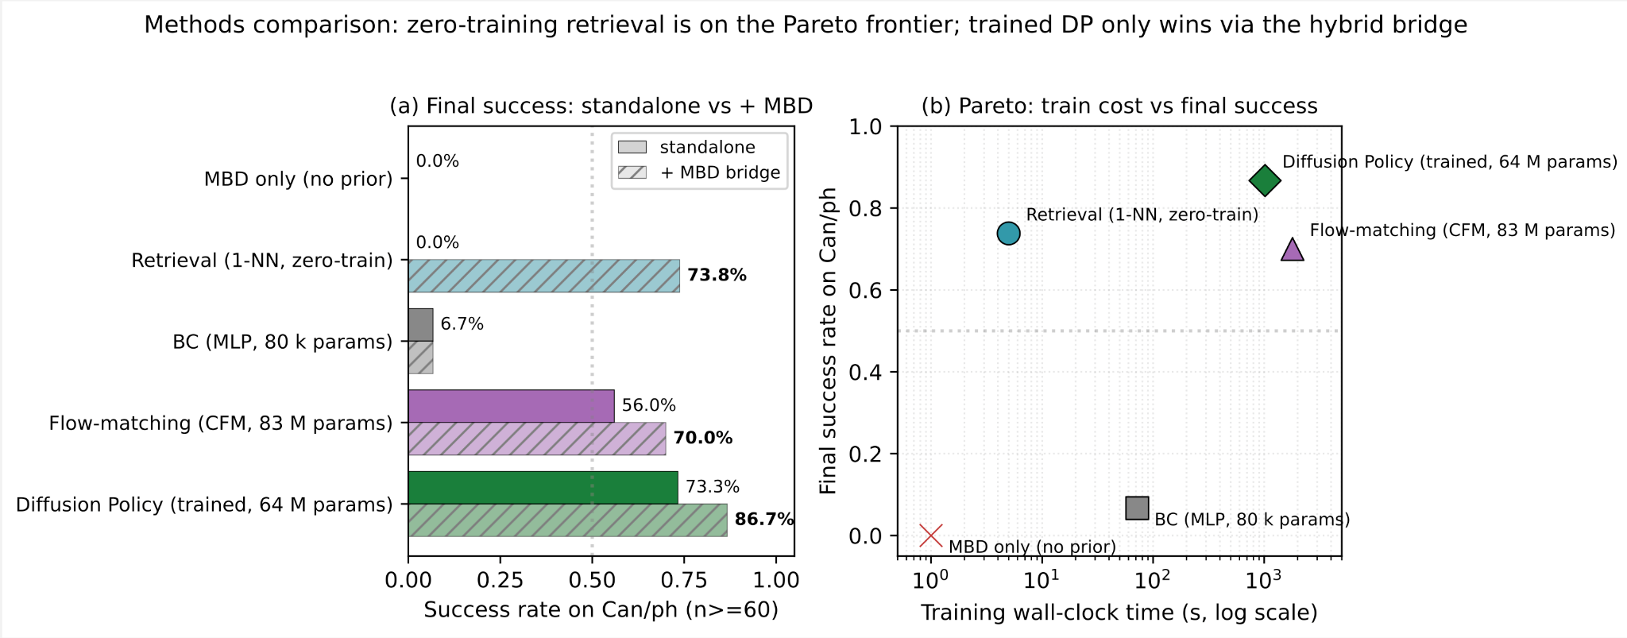
Testing Different Priors
This slide is updated after we realized that we failed to report a later version of Flow-matching model that is implemented correctly. The original plot can be seen here.

Slide 6
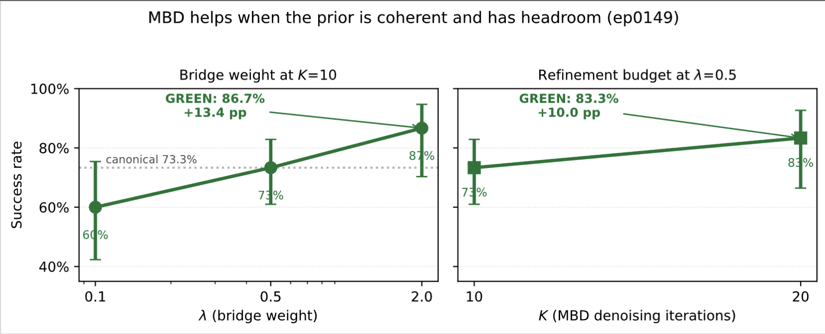
GREEN Cells
λ | Cell | Wilson 95 % CI | Lift vs canonical (λ=0.5)
0.1 | 18 / 30 = 60.0 % | [42.3, 75.4] | −13.3 pp
0.5 | 44 / 60 = 73.3 % | [61.0, 82.9] | (baseline)
2.0 | 26 / 30 = 86.7 % | [70.3, 94.7] | +13.4 pp GREEN
(All trials here are ran using DP prior)
λ controls the weight of the MBD correction relative to the prior.
  When λ is small, the prior dominates
  When λ is larger, MBD can pull the trajectory more strongly toward task success.
K controls the refinement budget: more denoising/refinement steps give MBD more chances to correct the sample.
Both sweeps reveal GREEN cells.
MBD helps only when the prior is useful but not saturated.
The lift comes from refinement, not from replacing the prior.

Slide 7
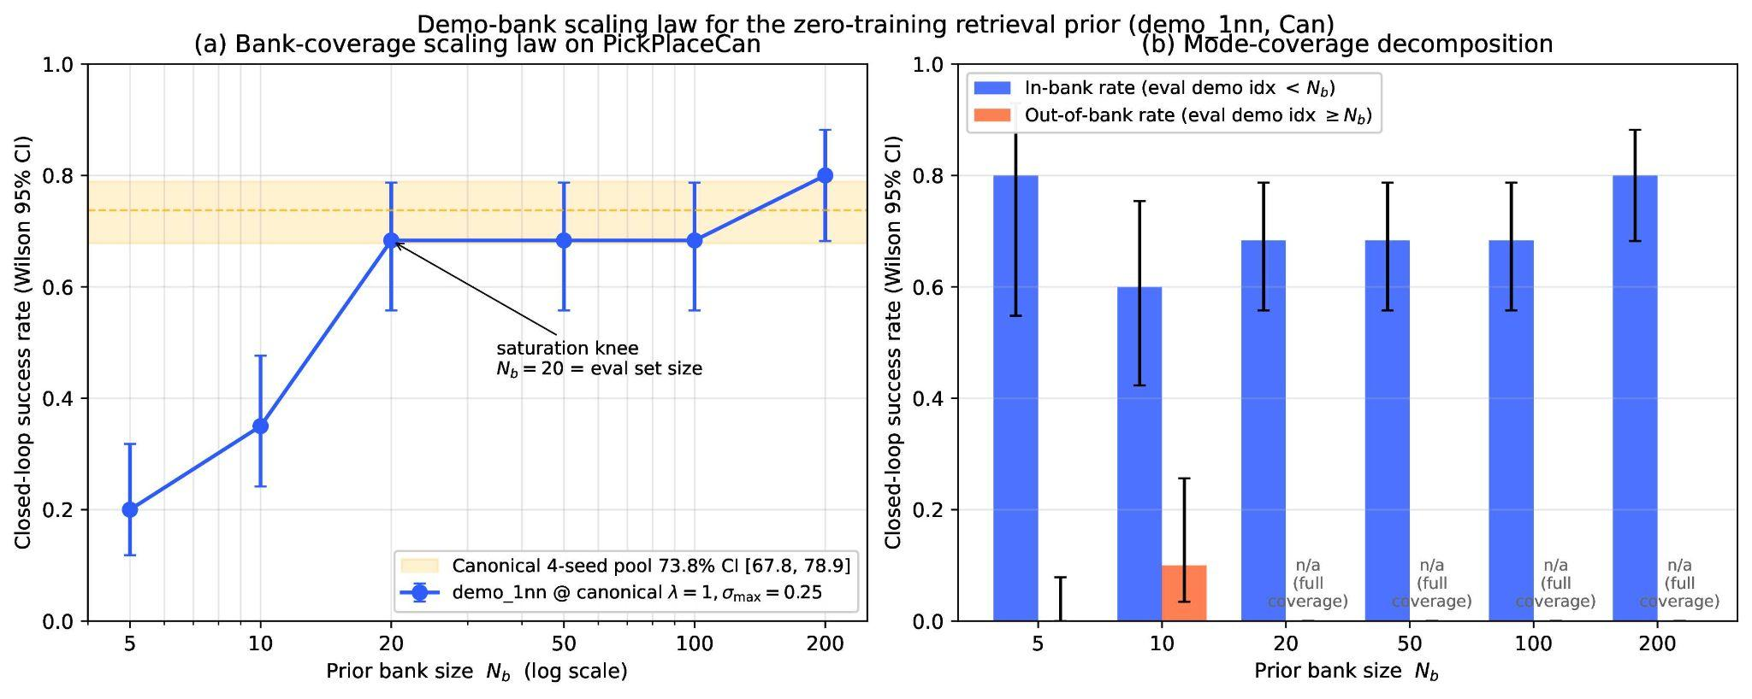
Adaptation Scaling
Can saturates by N_b ≈ 20, so demo-bank size is not the main limiter.
For harder modes like Square, simply adding demos is unlikely to fix the gap without a better prior or stronger adaptation.

Slide 8
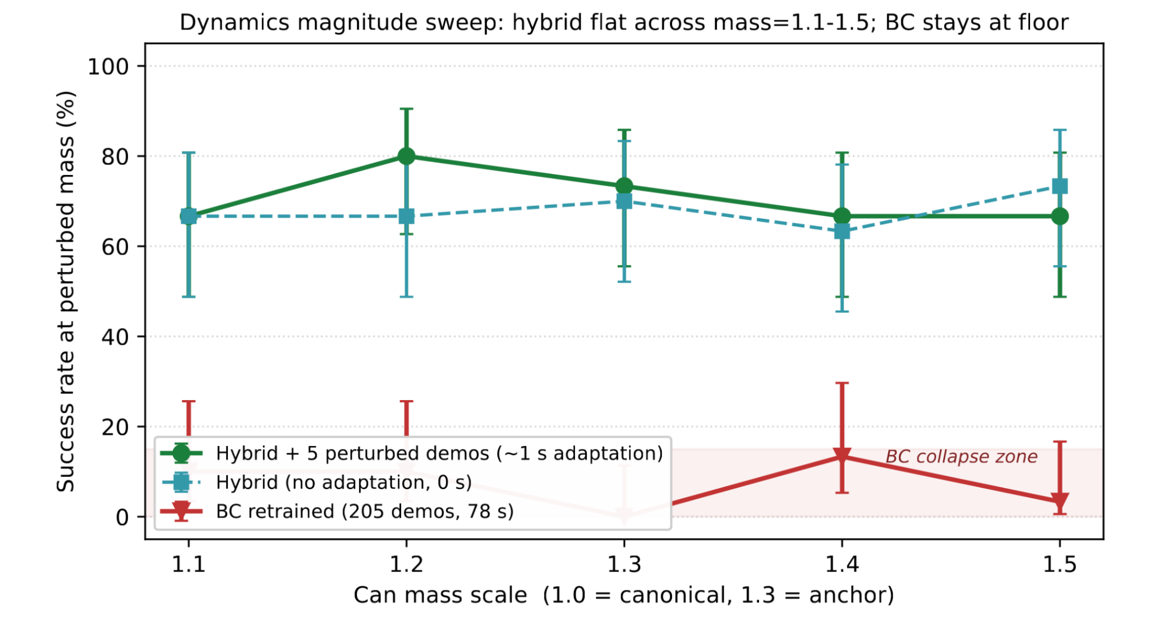
Adaptation on Dynamics
Retrained BC stays near the floor under mass shift.
Hybrid remains robust across the sweep.
~1 s adaptation with 5 demos further stabilizes performance.

Slide 9
Lessons
Use tiny datasets for conditioning, not retraining. Five new demos were enough to break our behavior-cloning baseline, but the same five worked well as retrieval targets. Small datasets are too noisy for reliable gradient updates.
Always run a no-op sanity check. When a method is turned off, the system should behave exactly like the baseline. A small reset bug cost us weeks because the “disabled” method was still changing behavior.
Sweep broadly before calling a method general. A prior can look strong in one narrow setting but fail nearby. Testing across wider settings helps reveal whether it is truly general or just a specialist.

Slide 10
Future Work and Conclusion
Conclusions:
Cross-task: Lift reaches 100%, Can reaches 73.8%, and Square is no longer stuck at the floor: with H = 300 and λ = 2, it reaches 50.0%.
Adaptation: We get a 78× speedup over retraining (about 1 s vs 78 s with 5 demos), and the result holds across 3 seeds and 5 mass scales from 1.1 → 1.5.
The prior gives a useful starting point, but the analytical cost gradient is what helps close the gap. Without that cost term, the inner loop stays below our headline Lift/Can results; with prior + cost gradient together, the method closes the gap.
Future work:
Fix tool_hang and transport. Reward-signal bug is patched; scored runs queued.
Push adaptation to N = 200 demos and wider perturbations.
Repeat adaptation under a trained-policy prior — does the 78× story generalise beyond retrieval?
Contrastive encoder for Square to break the 8 % representation ceiling.

Slide 11
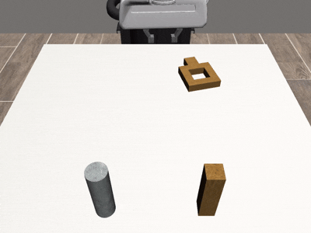
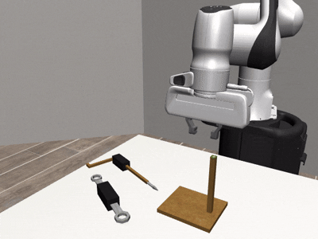
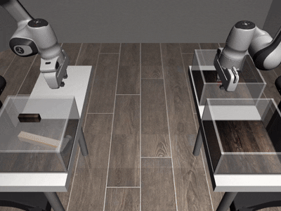
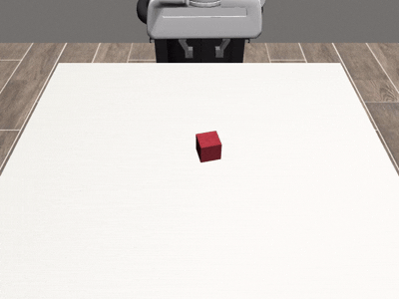
Thank you!
Questions?

